Slide 1
Git for WERC
Introduction to version control for code and data
Notes:
Images from https://git-scm.com/book.
Purpose of this presentation is threefold:
Illustrate the benefits of version control
Show how the functionality of Git and GitHub achieve those goals
How we’re going to use Git and GitHub in our day-to-day

Slide 2
Folder vs. Repository
Folder
Repository
filename-3_2-20150723.csv
Unreliable
Forgetful
Prehistoric
Hermit
filename.csv
Automatic
Elephant
Documented
Collaborative
Fewer headaches, better data.
Notes:
File names with dates and version names indicate the need for a repository
Repositories have the advantage of:
Automated versioning. Not prone to human error.
Every version is recorded in perpetuity.
Changes are not only recorded, they’re justified.
Collaboration is facilitated by branching and merging.
Data integrity

Slide 3
Command Line vs. GUI
What we will discuss
What we’ll gloss over
Git’s “Stream of snapshots”
File states
Basic commands
Other VCS software
Customization
Advanced commands
Pull requests
Notes:
We’ll be using the GitHub application in our work but I’m going to start to by teaching you the git command line tools
Why? Because you learn algebra before calculus. A lot happens ‘under the hood’ in the GUI that can lead to confusion if not well understood.
We’re going to talk about the important ideas driving Git and how they’re implemented in simple commands.
We’ll skip talking about alternative version control systems, Git’s advanced functionality, and GitHub’s Pull Request workflow. I call out pull requests specifically because they’re so integral to the open source development workflow that GitHub was built for, but we’re going a different way.

Slide 4
Create a Repository
git init alcidae
cd alcidae
ls -la
alcidae
.git
branches
config
description
HEAD
Notes:
Git is now initialized to start version controlling our files. Notice the .git directory – Git’s going to use that as a sophisticated archive to track history. How does it do that?

Slide 5
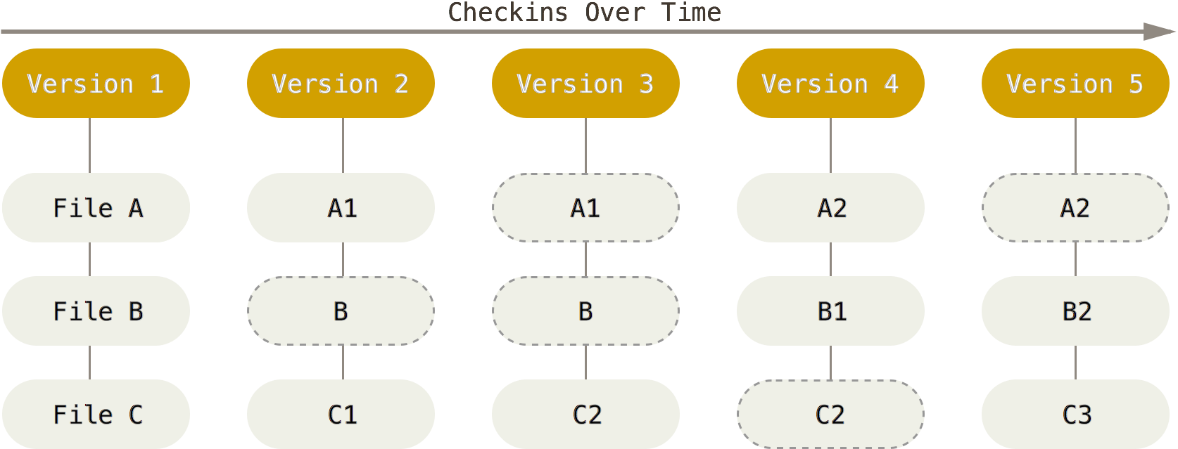
A Stream of Snapshots
Notes:
Git thinks of its data as a set of snapshots of a miniature filesystem. Every time you commit, or save the state of your project in Git, it basically takes a picture of what all your files look like at that moment and stores a reference to that snapshot. Let’s look at how snapshots (called commits) are made.

Slide 6
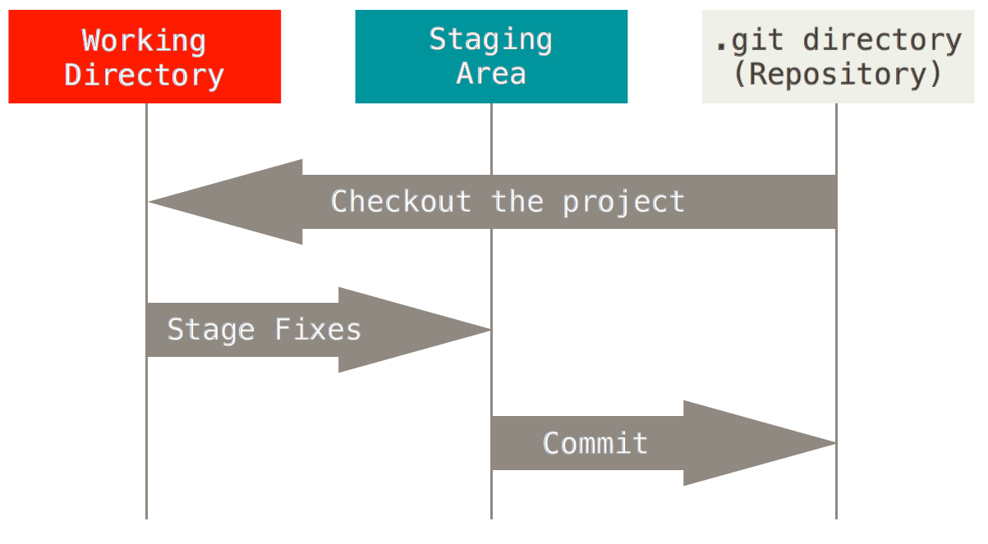
Three States
Notes:
Think of the working directory as the folders you’re used to. The .git directory is an invisible archive that holds the project’s history. The staging area is where files are transitioned from one state to the other. After you’ve done some work and you’re ready to create a snapshot, you’ll stage your changes and then commit them to the repository. Here’s an example.

Slide 7
Do Some Work Part I
echo “Types of auks” > README.md
mkdir cepphus
echo “Black Guillemot” > cepphus/columba.txt
git status
alcidae
README.md
cepphus
columba.txt
.git
Notes:
Let’s create some files and directories. Now execute git status to check in on Git.

Slide 8
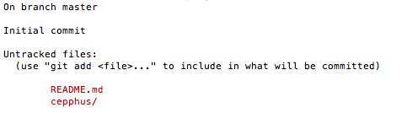
Untracked files
Notes:
Git warns us there are files in the Working Directory that aren’t being tracked yet. Essentially Git is aware of their existence but doesn’t know what to do with them. So we’re going to start tracking them and make our first commit.

Slide 9
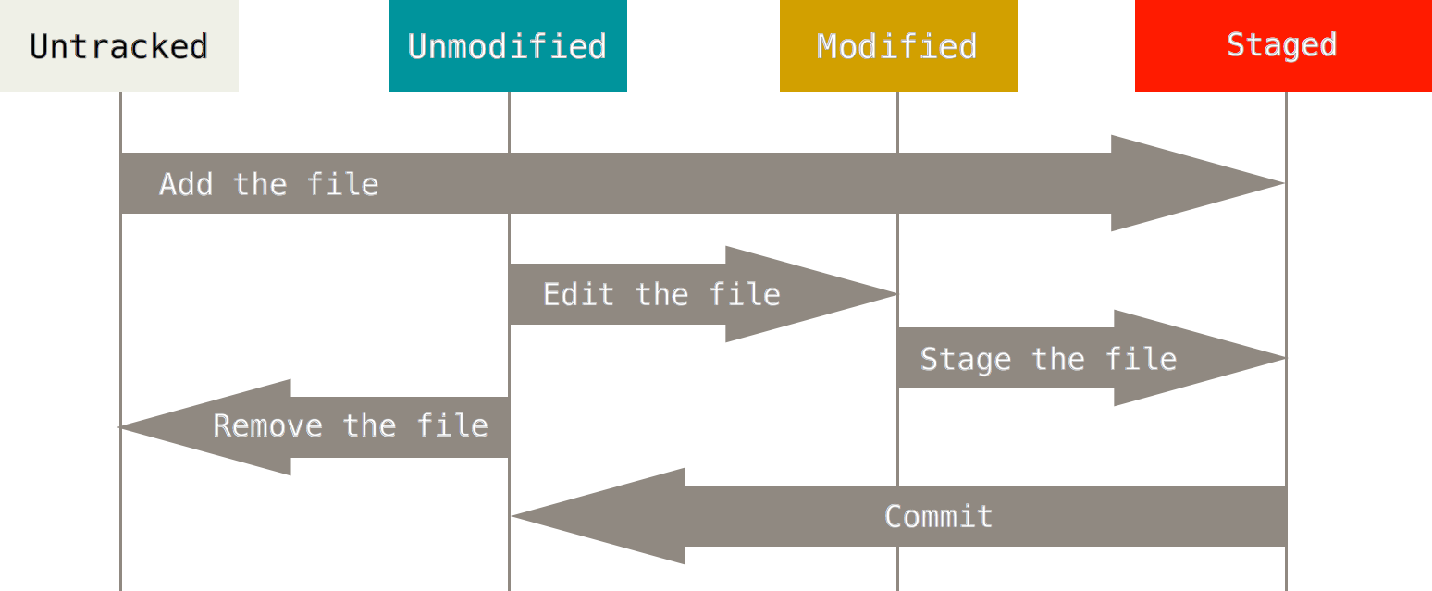
Staging Files Part I
Notes:
Currently all our work is Untracked. We need to add untracked files to the repo, which will also add them to the stage, before we can commit.

Slide 10
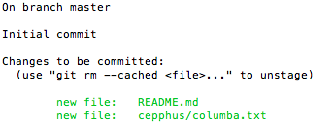
Our First Commit
git add README.md cepphus/columba.txt
git status
git commit –m “First commit”
Notes:
We’ve staged both our files and Git looks much happier now. So let’s go ahead and commit the changes.

Slide 11
A Stream of Snapshots
Notes:
Recalling our stream of snapshots, we just made our first one. We will, now and forever, always be able to return to this point in time.

Slide 12


Do Some Work Part II
git status
echo “Pigeon Guillemot” > cepphus/columba.txt
git status
Notes:
Let’s do some more work. If we run git status first, we’ll see everything is clean, as expected. But we just realized we got the common name of Cepphus columba wrong so we’re going to edit the file. Then we’ll check back in with Git. Now we have a modified file ready to be staged.

Slide 13
Staging Files Part II
Notes:
After our last commit, cepphus/columba.txt was Unmodified. Then we edited the file, leaving it Modified. Let’s stage our changes and make our second commit.

Slide 14

Our Second Commit
git add cepphus/columba.txt
git status
git commit –m “Corrected common name for PIGU”
Notes:
Once again we use git add. Think of it, not as adding files, but as adding changes to the stage.
Now git status is going to show us that the file is modified and ready to be committed. Notice that for our second commit, our message briefly describes why we made the change we did. In the future we’ll be able to look at the log and see that.

Slide 15
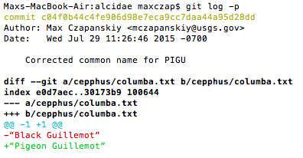
Why Commit Changes?
Logging
Branching and Merging
Reverting
Remotes
Notes:
Committing changes is the basic functionality underlying version control and its benefits are all built on top of that. What benefits?
Logging – Track changes. See differences between versions.
Branching and merging – Build separate streams of snapshots and, more importantly, unify the work
Reverting – Make changes fearlessly. You can always return to an earlier state.
Remotes – Push changes to a server so everyone can have them. This connects your local repository to a globally accessible one.

Slide 16
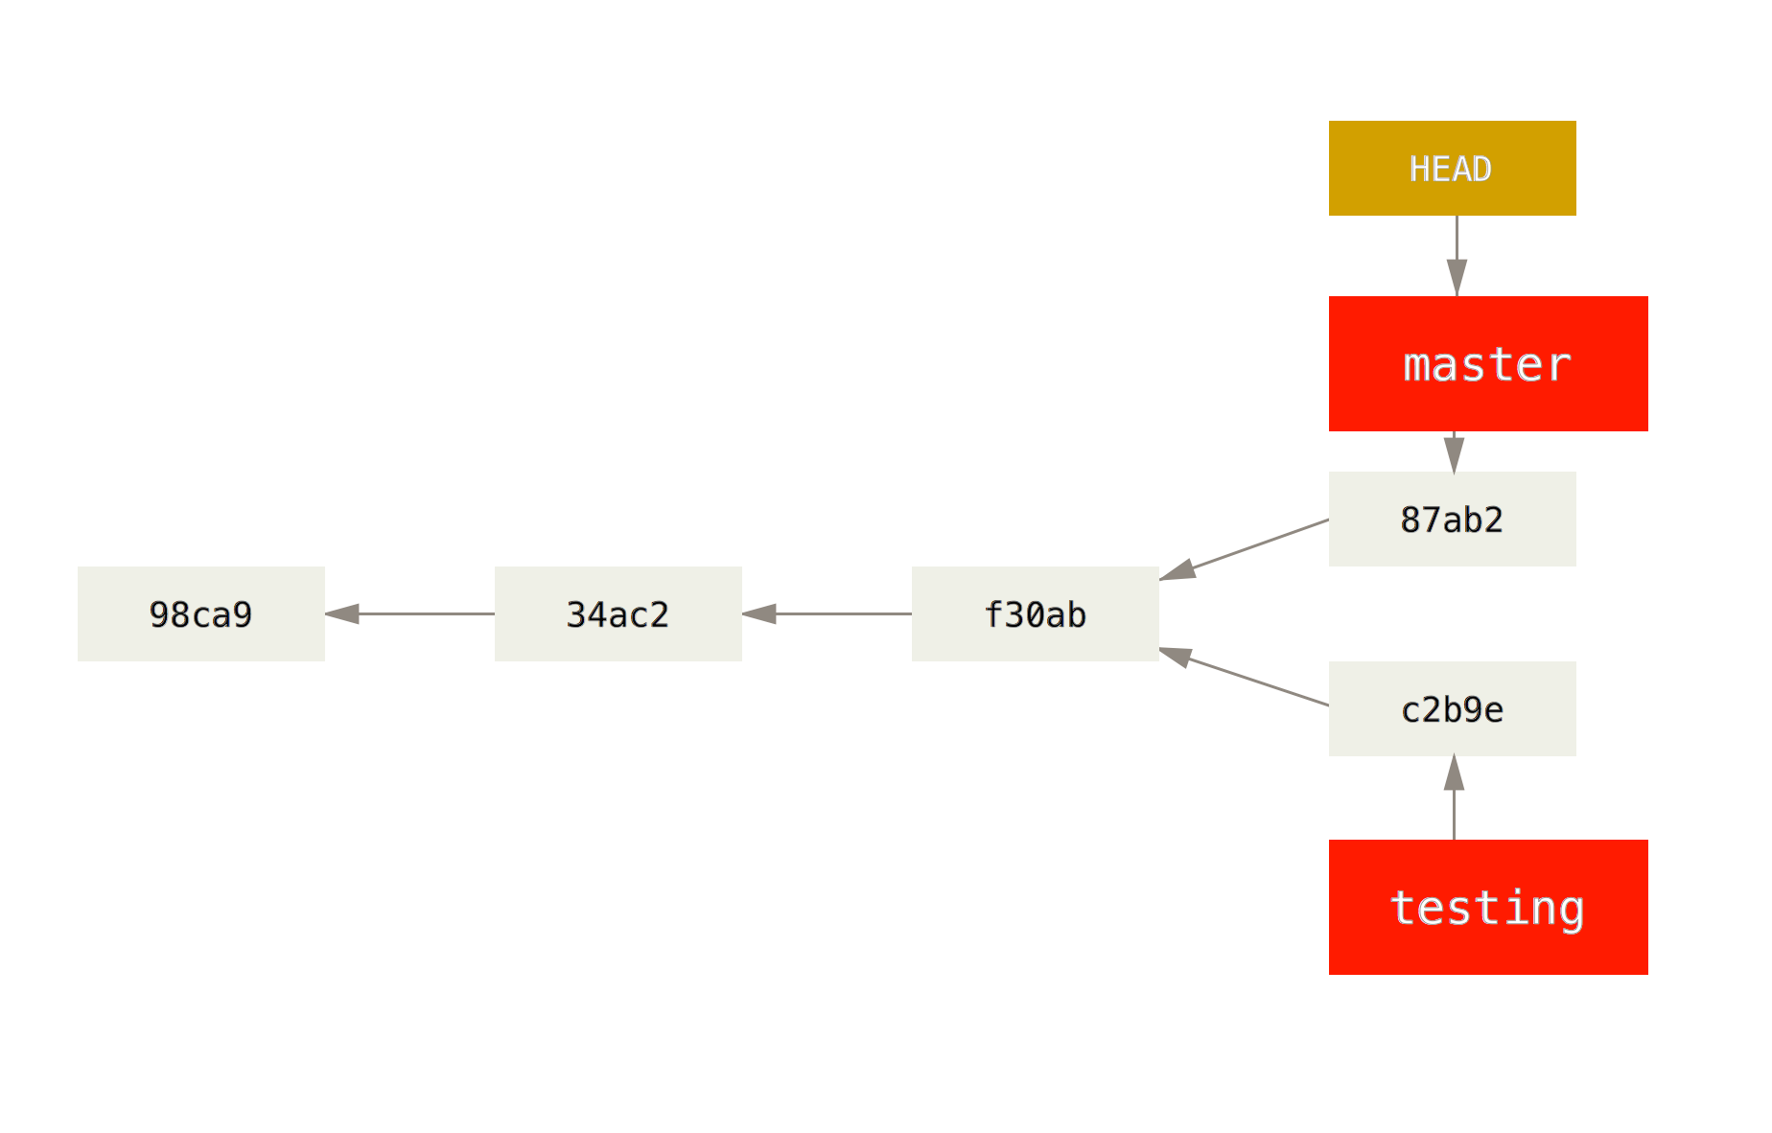
Branching Part I
Notes:
Each snapshot inherits from an earlier snapshot
Branches are pointers to a snapshot (you’re always on a branch – by default it’s master)
HEAD is a pointer to which branch you’re on
Moving between branches does two things:
HEAD points to a new branch
Git unpacks the snapshot into your Working Directory

Slide 17
Branching Part II
Notes:
Remember the three states?
Switching branches is also called a checkout.
The Repository contains the state of the branch you’re moving into. Git unpacks those files and moves them into your Working Directory.
Key point: You, the user, never need to manually move files around. Git does that automagically.

Slide 18
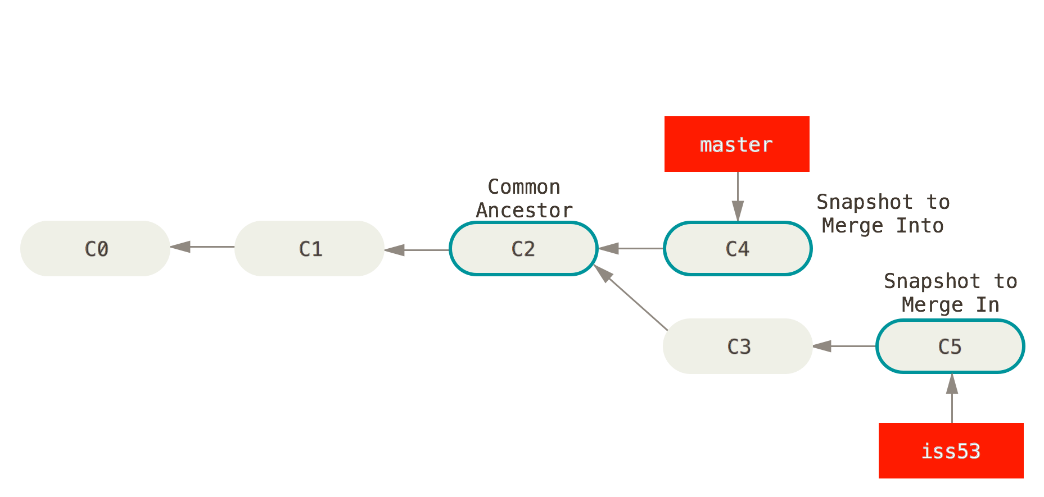
Merging Part I
Notes:
The situation: Emma’s made changes for a hypothetical Issue 53
First she created a new branch off of snapshot C2
She checked in two batches of changes, C3 and C5. Perhaps C3 is new code and C5 is some new data.
Meanwhile, Jon has been working on the master branch and checked in his own batch of changes, C4.
Emma is satisfied that her work is solid and she wants to merge her changes back into the master branch
Big picture: Git will figure out where the branches split and how best to unify them

Slide 19
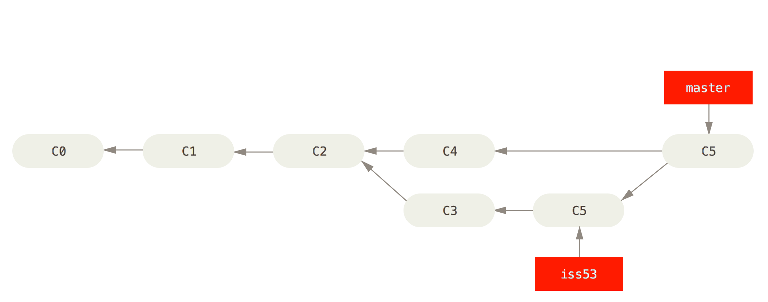
Merging Part II
Notes:
After Emma merges her changes into the master branch we get a special snapshot that has two parents instead of just one
What would Emma and Jon have needed to do in the old system?
Check to make sure their work doesn’t overwrite each other (Git checks for merge conflicts and provides tools for fixing them)
Distribute the files to each other
Hope they didn’t forget anything

Slide 20
Reverting
How to revert:
email or chat mczapanskiy@usgs.gov
Notes:
All the ways of reverting files are simple. But there are a lot of them and it depends exactly on the kind of reversion you want to do.
Do you want to erase your recent modifications?
Do you want to temporarily revert and then return to where you were? (e.g. you want to compare the results from older code against your recent code)
Do you want to wholesale return to an earlier snapshot or do you want to just revert one file?

Slide 21
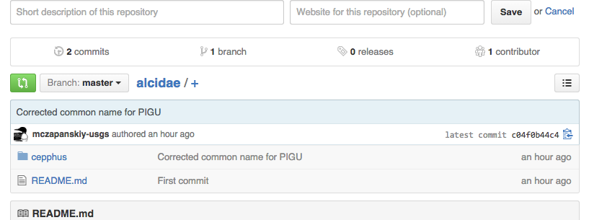
Remotes
Where Git meets GitHub

Slide 22
Pushing Your Repo
Create a repo on GitHub
Add the remote to your local repo
Push it!
Check GitHub’s website to see the magic
Notes:
Note: you’ll need your GitHub password for this
Log in to github, create new repo, calll it alcidae
Copy the first command into your terminal to add remote to local repo, enter username and password
Copy the second command to push your local to your remote
Return to GitHub, view changes

Slide 23
Git and GitHub in Your Life
What repo should I use?
When should I commit? And push?
What should I commit?
When should I branch? And merge?
How does using Git and GitHub make my life easier?
Notes:
The questions you should be asking:
WERC-SC
Whenever you feel you’ve reached a good stopping point. As long as you’re working locally or on your own branch it’s very difficult to commit too often. Push to share or to back up.
Always commit code and documentation. Commit data if it’s reasonably sized (no files > 100MB, total repo < 1GB)
In general you should be on your own branch. Only merge into master if what you have is in working order.
Explore the tools. Use the history logs, use the visual diffs. Sync with GitHub instead of emailing code snippets.

Slide 24
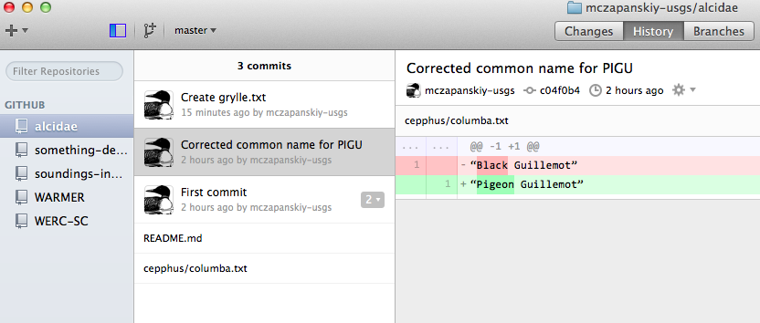
Command Line vs. GUI Revisited
Notes:
In practice you won’t be using the command line. In the unlikely scenario that you run into an issue that can’t be handled by the GUI it’s best to get in touch with me.
History of snapshots (commits)
Visual file diffs
Tabs for committing changes, browsing the log (history), switching between branches

Slide 25
In Conclusion
Growing pains
Better code and data management
Facilitated collaboration
Ask questions!
Me
Google
Stack Overflow
Notes:
Version control:
Does have a learning curve and there is an overhead cost (writing commit messages, fixing merge conflicts). But you’ll find the benefits far, far, far outweigh these costs.
Will revolutionize how you write code. Locating and tracking changes to data will be better documented.
The first time you merge your changes into the master branch will give you shivers. Never search your email for code snippets again!
GitHub has an incredible ecosystem surrounding it. In terms of users and documentation it’s the Facebook of source control. You’re never going to be the first person to encounter an issue and I guarantee someone online will have an answer for you.

Slide 26
Resources
Try GitHub Exercises
GitHub & Git Foundations Videos
Git Documentation

